Slide 1

Interpretable Multi-Task Machine Learning Framework for Multi-Use Water Quality Indexing
Instructed By
Dr. Vijayalakshmi Ramasamy
Assistant Professor
Georgia Southern University
Presented By
Md. Rajaul Karim
Md. Jahidul Islam
Data Science and Machine Learning
Date: 03.12.26
Notes:
Slide 1: Title Slide
Write Script Here .

Slide 2

Introduction (Cont.)
WQI is a single numerical value (typically 0-100) that summarizes complex physical, chemical, and biological data to represent the overall health of a water body.
Machine learning enables the following:
Automated WQI prediction and Forecasting
Modeling of complex environmental relationships
Scalable monitoring systems
Widely Used ML models for WQI predictions: DT, RF, SVM, GB, XGB,
DL models: ANN, CNN, RNN, LSTM, etc., are widely used for the prediction and forecasting of the water quality index

Slide 3


Literature Review
Notes:
Slide 11: Literature Review
To build our system, we studied other related research and papers.
We found that many existing systems use blockchain but still have some problems, like high cost, lack of real-time data, and no support for updates.

Slide 4
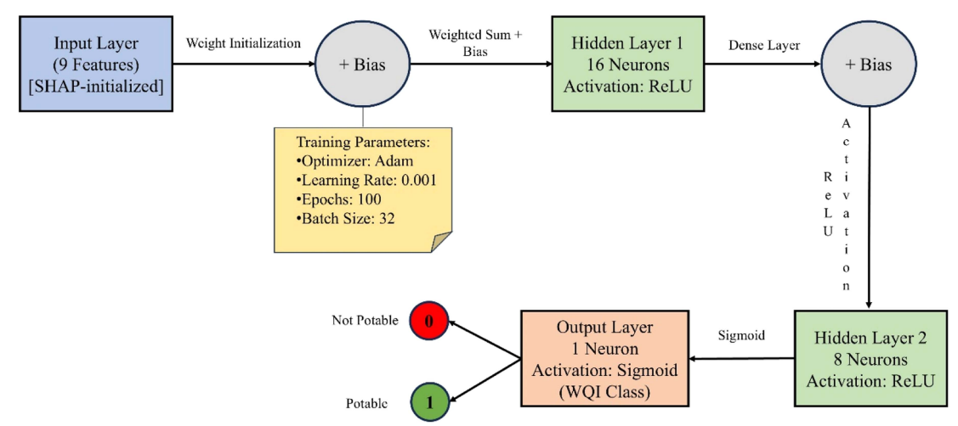
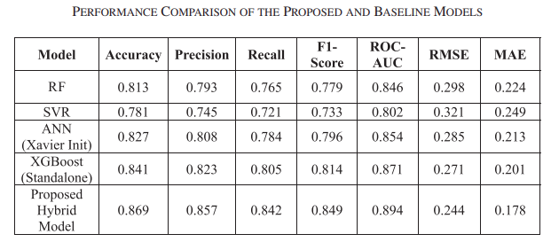
Literature Review (1/3)
A hybrid machine learning framework for water quality index prediction using feature-based neural network initialization (Bataineh et al., 2026)
Problem Addressed:
A combined model that uses XGBoost and SHAP to set up a neural network can make predicting the Water Quality Index more accurate than older methods.
Methods:
The hybrid ANN + XGBoost model (proposed model) baseline models for comparison: Random Forest, Support Vector Regression, Standard ANN, and Standalone XGBoost.
Limitations/Gaps:
The dataset employed binary classification, although multiple classification is necessary in real life. There is no specific reference to potability measures.
Fig. 1: Architecture of the proposed neural network model for WQI prediction.
Framework achieved:
Accuracy of 86.9%,
F1-score of 0.849
Receiver operating characteristic–area under the curve of 0.894

Slide 5
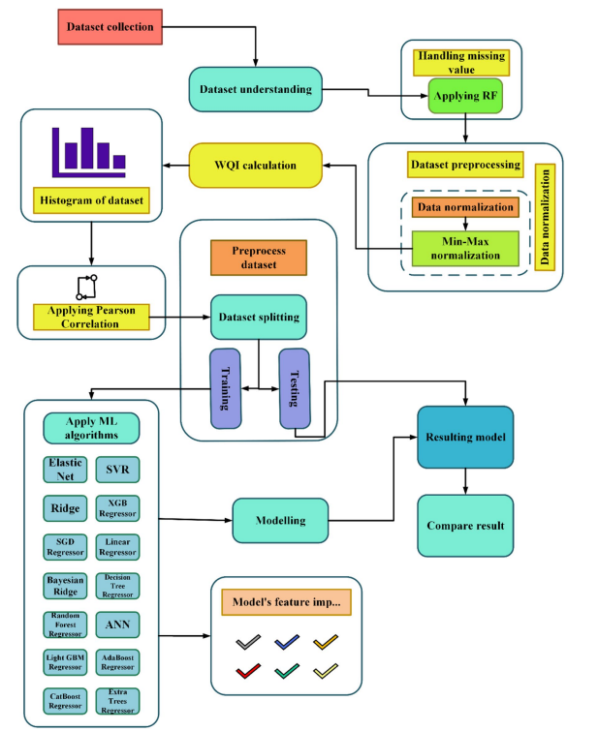
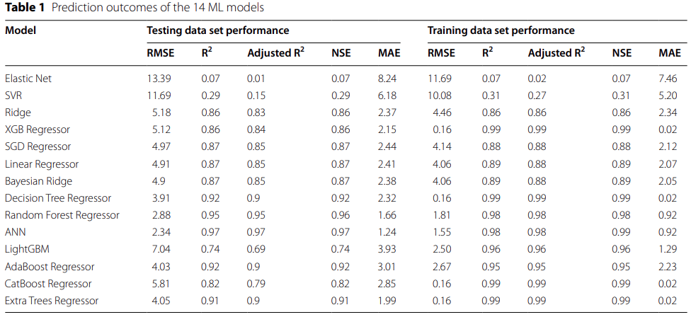
Literature Review (2/3)
Comparative analysis of machine learning models for predicting water quality index in Dhaka's rivers of Bangladesh (Nishat et al., 2025)
Problem Addressed:
Dhaka rivers are severely contaminated by sewage, industrial discharge, and urban runoff; precise Water Quality Index (WQI) forecasting is required for environmental management.
The ANN model demonstrated superior predictive capability,
Root Mean Squared Error (RMSE) of 2.34,
Mean Absolute Error (MAE) of 1.24
Nash–Sutcliffe
Efficiency (NSE) of 0.97,
Coefficient of Determination (R2) of 0.97
Methods:
Machine Learning Models (14): ANN, RFR, Decision Tree Regression, Linear Regression, Ridge Regression, SGDRegressor, XGBoost, etc.
Limitations/Gaps:
The models rely on historical data, lack climatic elements, face limitations in regional datasets, and have restricted physicochemical parameters. Very small dataset.
Fig. 2: Working algorithm of the ML models

Slide 6
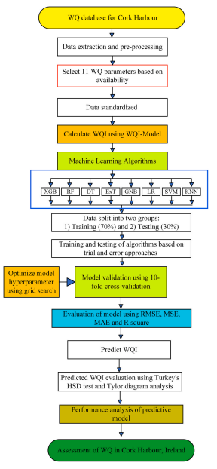
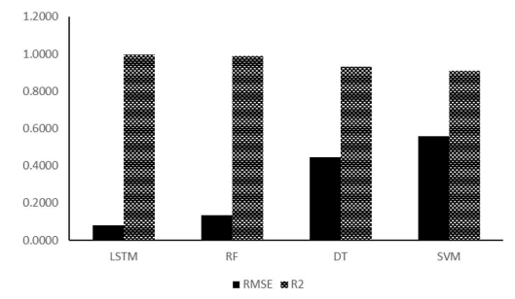
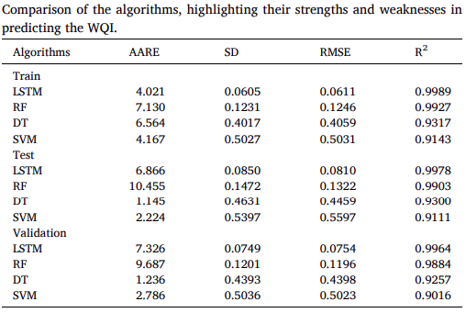
Literature Review (3/3)
Predicting and investigating water quality index by robust machine learning methods (Han et al., 2025)
Problem Addressed:
How to use machine learning to precisely estimate and categorize the Water Quality Index (WQI) to enhance environmental sustainability and urban waste management.
Methods:
LSTM (Deep learning), Random Forest, Decision Tree, Support Vector Machine.
Limitations/Gaps:
Single-municipality dataset; restricted geographic generalization; potential bias in the dataset; computational difficulty; problems with scalability.
LSTM demonstrated the most significant advantages, achieving superior predictive accuracy and precision across training, testing, and validation datasets,
RMSE values of 0.0611, 0.0810, and 0.0754
R2 values consistently above 0.9964
Fig. 3: A comprehensive framework for the assessment of predicting WQIs

Slide 7
Similarities Between Existings Methods
Common Research Focus:
Predicting or classifying Water Quality Index (WQI) using ML/DL
Improving accuracy, robustness, interpretability, and real-world usability
Most Used Methods:
Tree/Ensemble Models: RF, XGBoost, LightGBM, GBT
Deep Learning: ANN, LSTM
Hybrid / Stacking Models: ANN + XGBoost, stacked ensembles
XAI Methods: SHAP and LIME used in a few recent studies

Slide 8
Similarities Between Existing Methods (Cont.)
Dataset Patterns:
Mostly region-specific datasets (USA, India, Ireland, China, UK)
Common inputs: pH, DO, BOD, COD, EC, TDS, turbidity, nutrients
Many studies used small- or moderate-sized datasets
Key Findings Across Papers:
Ensemble and hybrid models usually achieved the best performance
LSTM / deep learning performed well when temporal patterns existed
XGBoost / RF / LightGBM were among the strongest traditional ML models
SHAP improved interpretability and feature importance analysis

Slide 9
Major Strengths of the Existing Study
Strong Comparative Modeling
Good Predictive Accuracy
Practical Environmental Applications
Some Integration of XAI and Multi-task Learning

Slide 10
Major Gaps Between Existing Methods
Limited generalization due to regional datasets
Small data size in many studies
Lack of universal/adaptive WQI framework
Majorities focus on predictive accuracy rather than appropriate feature identification.
Few studies combine classification and/or regression and explainability.
Most of them are used for predicting or forecasting a single water quality index.

Slide 11
From Literature Review to Research Direction
Identifies key limitations of traditional WQI models (rigid weighting, poor generalization).
Summarizes and compares ML, DL, and hybrid approaches from the literature.
Highlights performance trends (DL > ML, hybrid models most effective).
Extracts important datasets and their challenges (small size, scattered, non-standard).
Identifies major research gaps:
Lack of real-time systems
Limited XAI (SHAP) usage
Poor scalability and generalization

Slide 12
From Literature Review to Research Direction (Cont.)
Translates literature findings into a clear problem statement.
Justifies the need for a new/improved framework.
Supports development of a proposed methodology (e.g., hybrid DL + XAI).
Provides a foundation for model design, dataset selection, and evaluation metrics.
Bridges the gap between existing research and your proposed contribution.

Slide 13
Research Questions
How do machine learning models improve WQI prediction and classification compared to traditional statistics?
Can a generalized WQI model support multiple uses (drinking, irrigation, ecosystem health and etc.)?
Which ML approaches improve generalization and efficiency across multiple WQI models?
How can XAI be integrated into an ML-based water quality assessment?

Slide 14
Objective of the Project from the SLR
To propose a multi-task ML framework for predicting use-specific WQI’s from a single set of water quality parameters.
To incorporate XAI to provide both local and global interpretability, ensuring transparency and domain alignment.
Improved generalization and efficiency by leveraging feature representations across WQI’s, reducing redundancy compared to a traditional single-task model.

Slide 15

Data Collection and Wragling
Notes:
Slide 11: Literature Review
To build our system, we studied other related research and papers.
We found that many existing systems use blockchain but still have some problems, like high cost, lack of real-time data, and no support for updates.

Slide 16
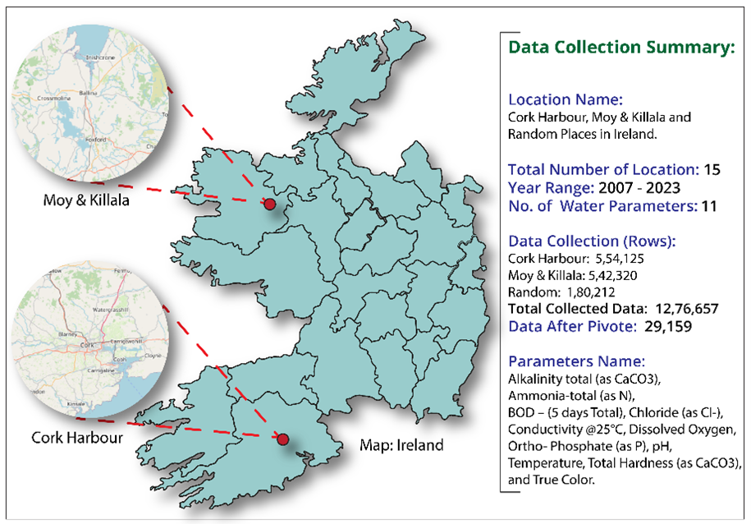
Selected Data Source and Dataset Summary
Notes:
Slide 15: Methodology
✨ Now I would like to introduce my teammate, ____.
He will continue with the next part of our presentation.

Slide 17
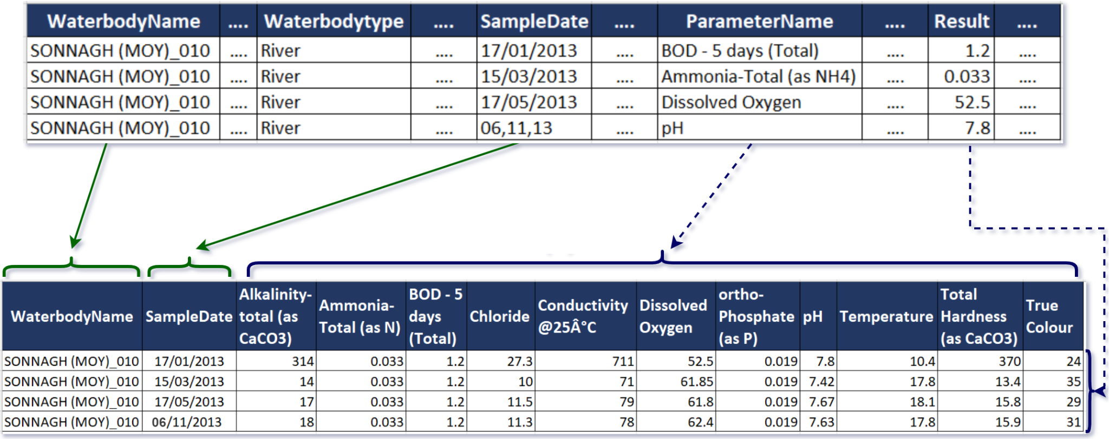
Dataset Pivote
Notes:
Slide 15: Methodology
✨ Now I would like to introduce my teammate, ____.
He will continue with the next part of our presentation.

Slide 18
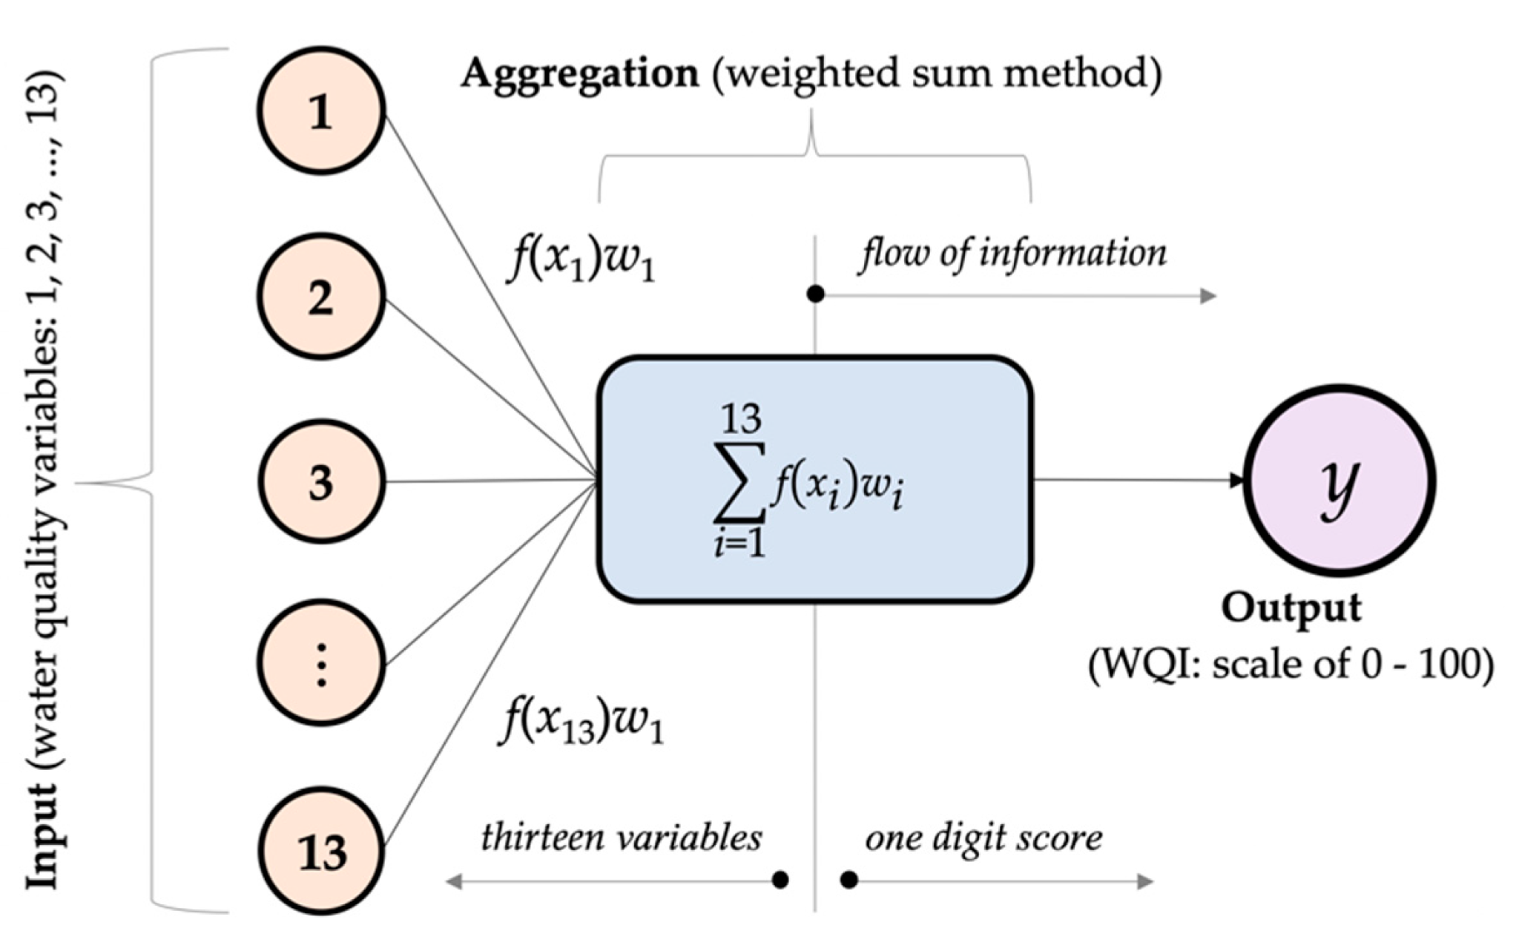
Water Quality Index Model Implementation
Selected Water Quality Index Models:
Drinking Water Quality Index (DWQI) - Drinking and Household Purpose
Aquaculture Water Quality Index (AWQI) - Fisheries, Lake, Water Species
Irrigation Water Quality Index (IWQI) - Agricultural and Irrigation Purpose
Industrial Water Quality Index (IndWQI) - Industry Purpose
WQI Implementation Phases:
Parameter Selection
Sub-index Calculation
Parameter Weighting
Aggregation Function
WQI Classification
Notes:
Slide 15: Methodology
✨ Now I would like to introduce my teammate, ____.
He will continue with the next part of our presentation.

Slide 19
Exploratory Data Analysis (EDA)
Notes:
Slide 11: Literature Review
To build our system, we studied other related research and papers.
We found that many existing systems use blockchain but still have some problems, like high cost, lack of real-time data, and no support for updates.

Slide 20
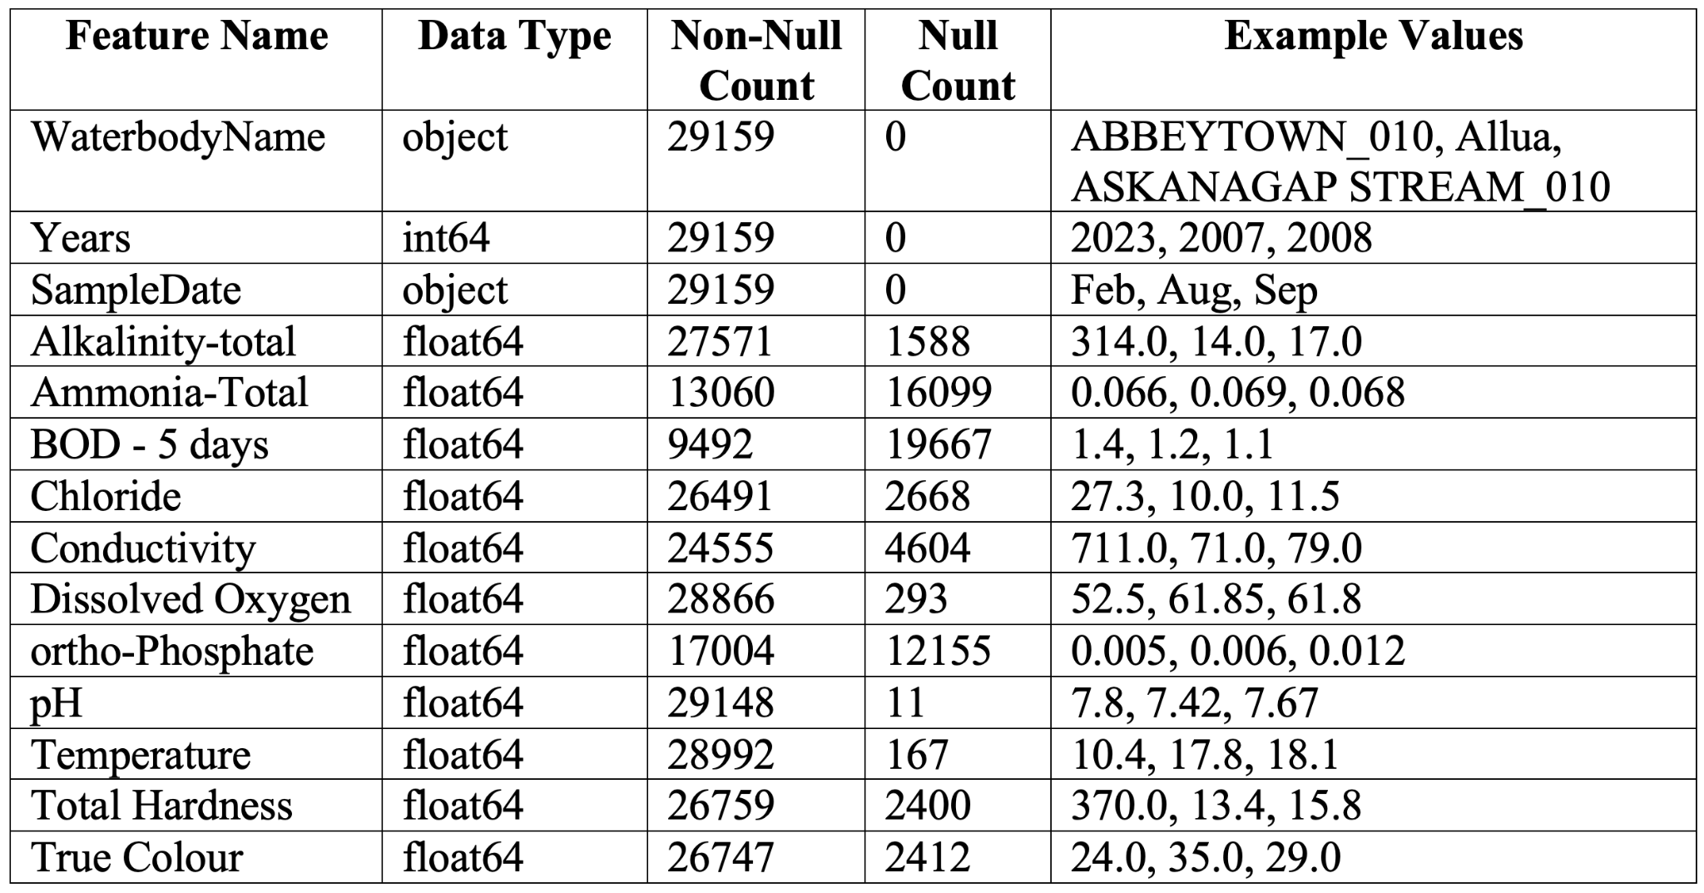
Data Details

Slide 21
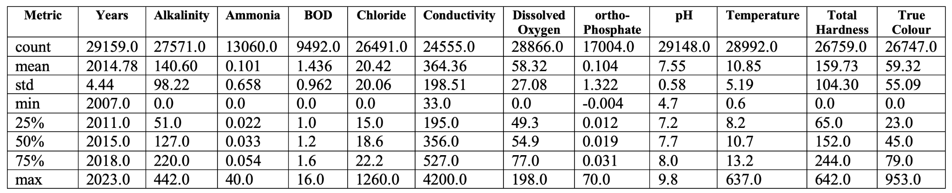
Data Description and Summary

Slide 22
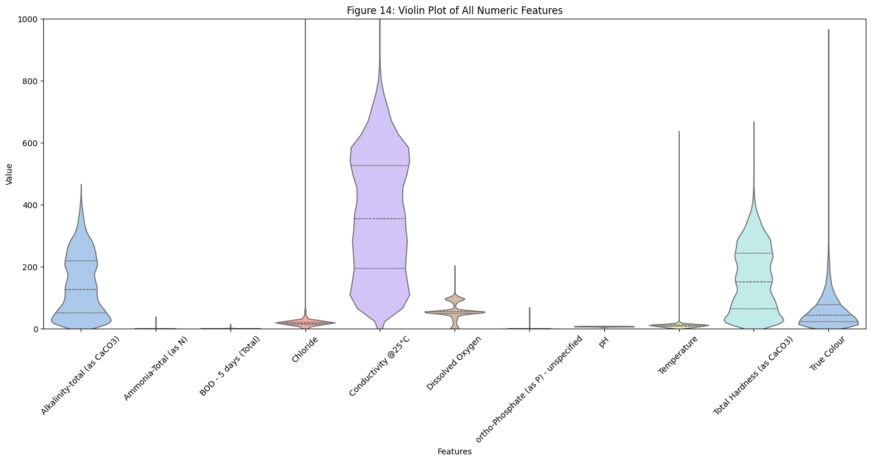
Violin Plot of the Raw Dataset

Slide 23
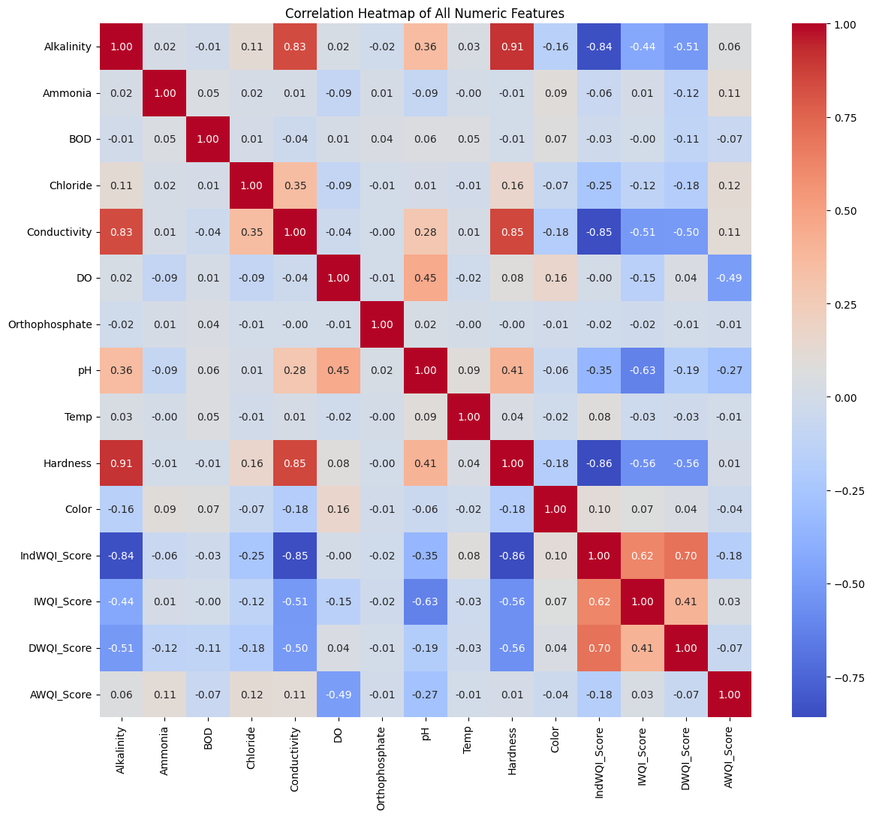
Feature Correlation

Slide 24
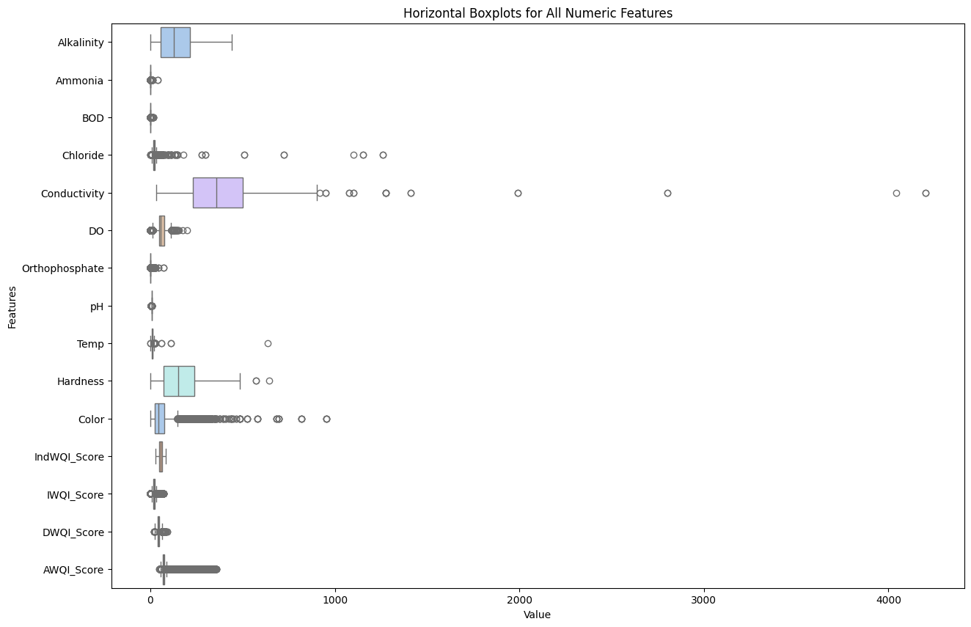
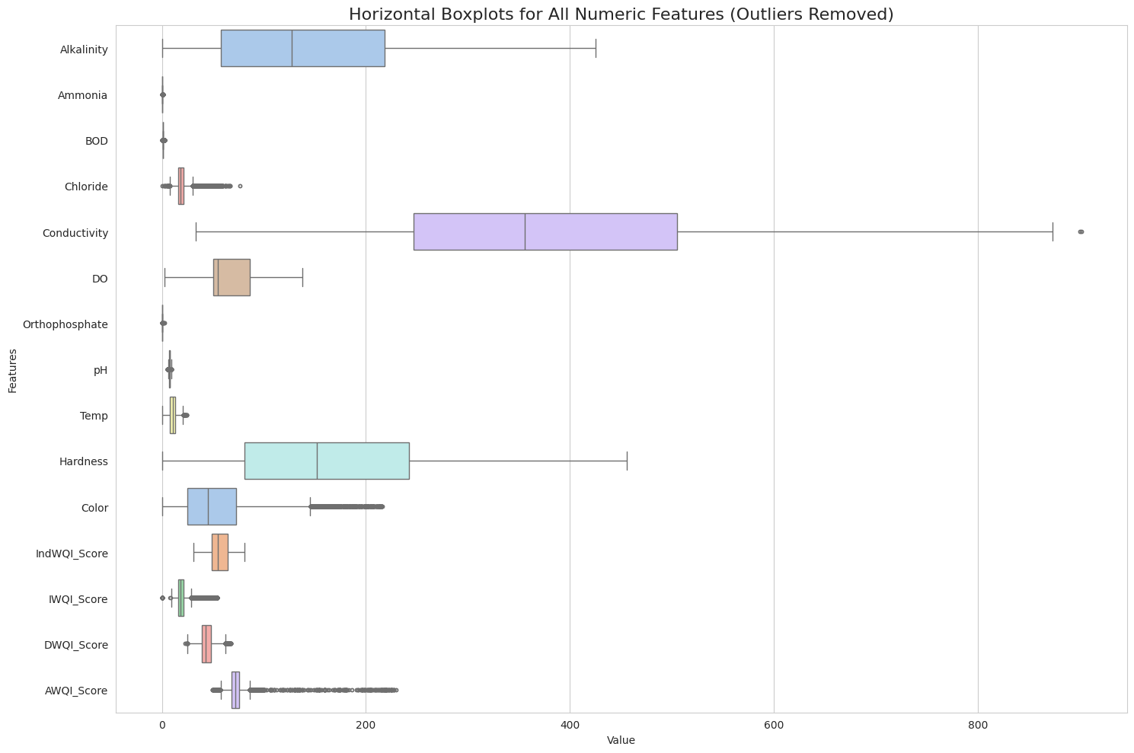
Dataset before Removing and after Removing Outliers

Slide 25
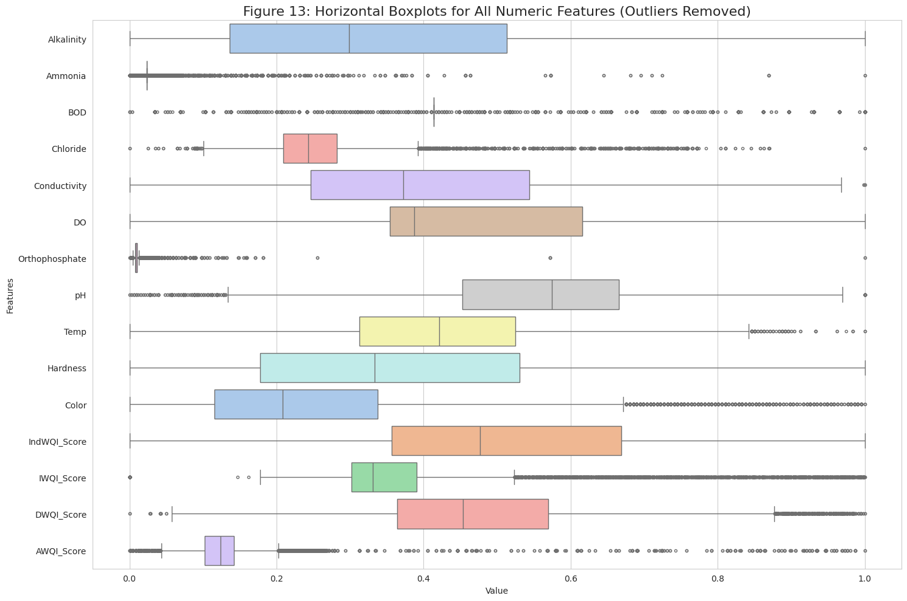
Feature Representation After Scaling/Normalization

Slide 26
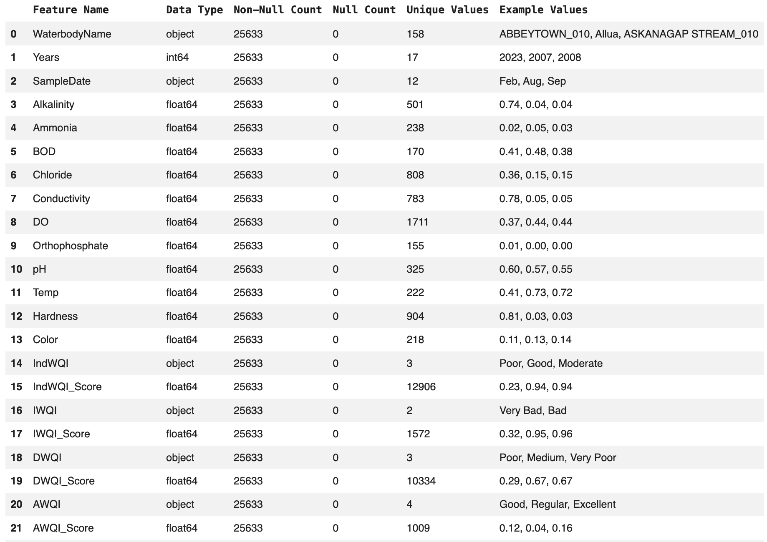
Data Summary After WQI Calculation

Slide 27
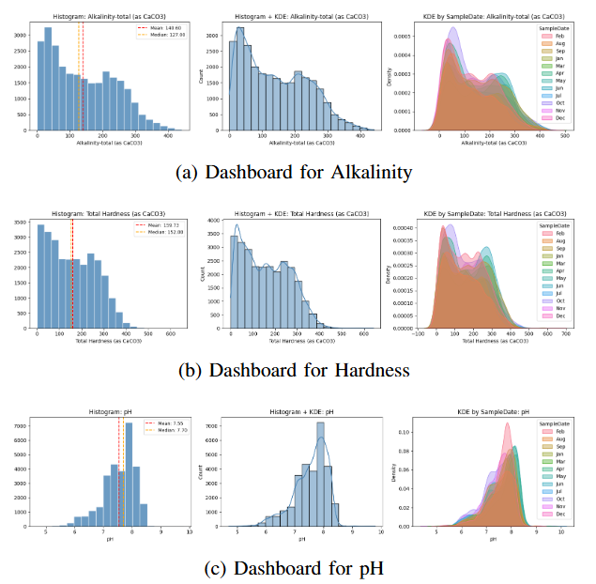
Feature Distribution for Top 3 Features

Slide 28
Challenges Encountered
Collected data from multiple locations across Ireland using catchment data sources, files were stored in various subdirectories, identifying the correct datasets for download was initially challenging.
After downloading, merging files based on common features proved difficult. Initial attempts using Python resulted in inconsistencies, so we used Microsoft Excel pivot tables and applied filtering to ensure accurate record matching.
During water quality index modeling, we found that the collected datasets were missing key parameters. This required repeating the entire data collection and preprocessing process, which was time-consuming.
Defining standard parameter ranges and assigning appropriate weights was challenging due to the lack of a universal guideline for water quality index calculations.

Slide 29

State-of-the-Art Models Implementation
Notes:
Slide 15: Methodology
✨ Now I would like to introduce my teammate, ____.
He will continue with the next part of our presentation.

Slide 30
Implementation of the SOTA
Baseline models implementation: common environment and dataset
Result Analysis
Comparison with the baseline models
Finding the next feasible steps towards Milestone-3
Determining the best method for predictive modeling (Milestone - 3)

Slide 31
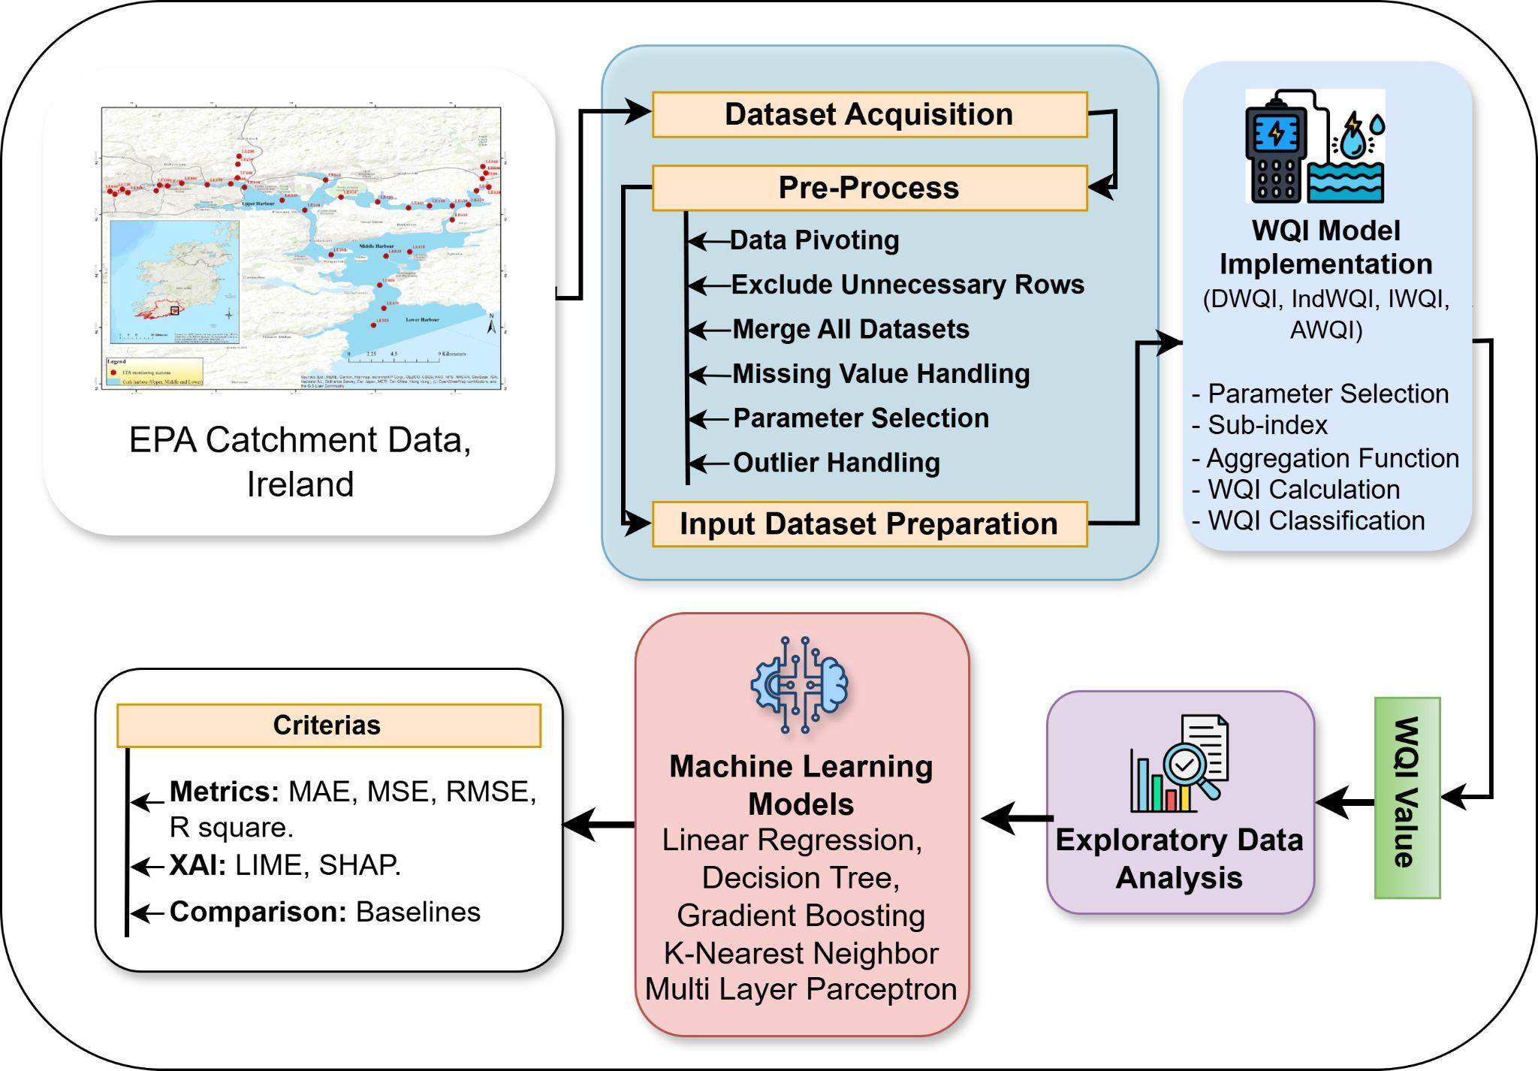
Overall pipeline of the study for Milestone II

Slide 32

Result Analysis

Slide 33
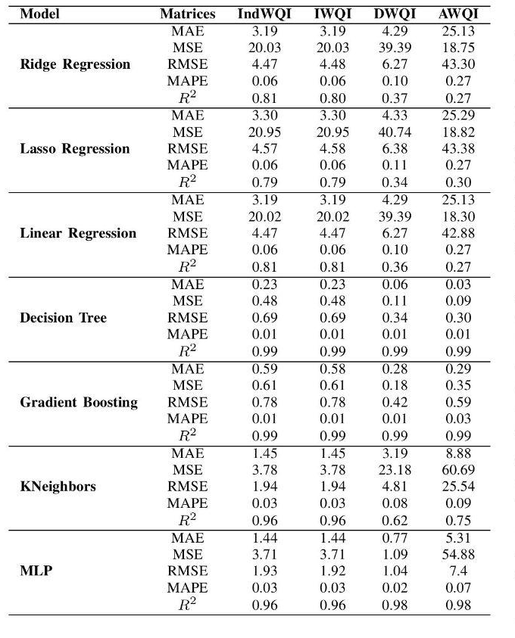
Comparison Among State-of-the-art Models
Baseline Models
Notes:
Slide 15: Methodology
✨ Now I would like to introduce my teammate, ____.
He will continue with the next part of our presentation.

Slide 34
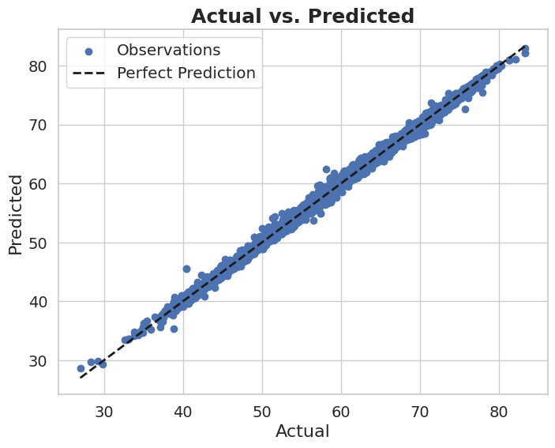
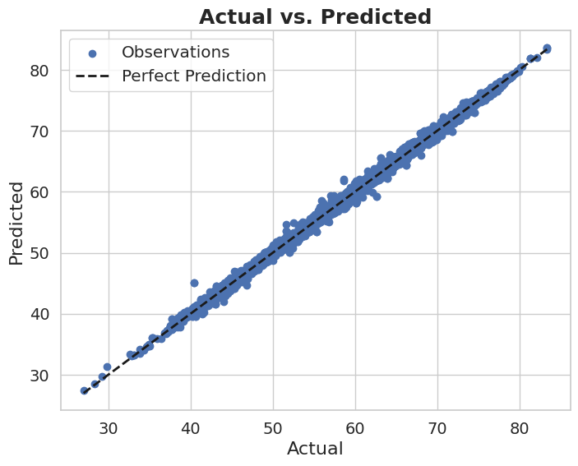
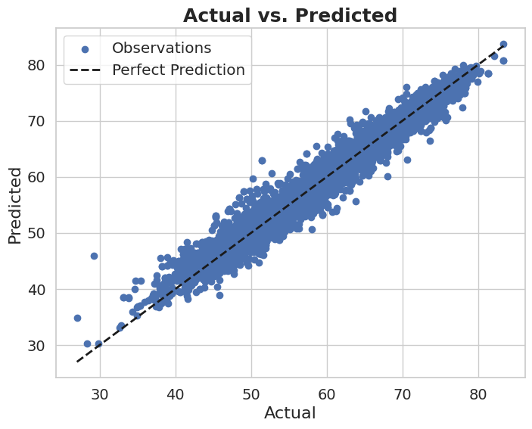
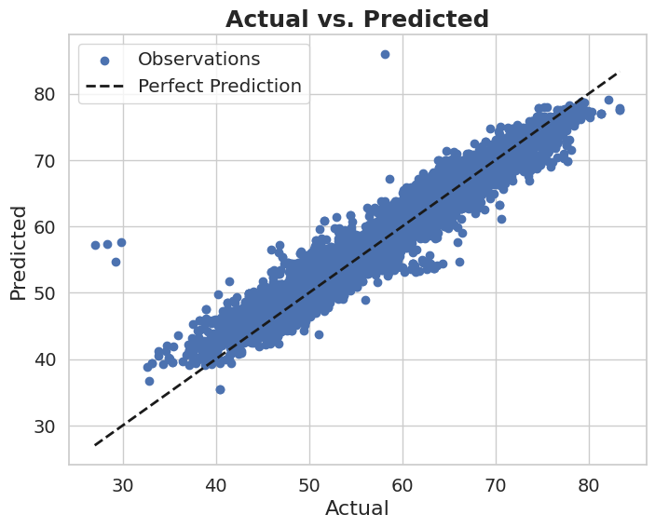
Prediction Result: Irrigation Water Quality Index (IWQI)
XGB Regressor
LightGBM Regressor
KNeighbors Regressor
Support Vector Regression (SVR)
Best Prediction
Worst Prediction
Notes:
Slide 15: Methodology
✨ Now I would like to introduce my teammate, ____.
He will continue with the next part of our presentation.

Slide 35
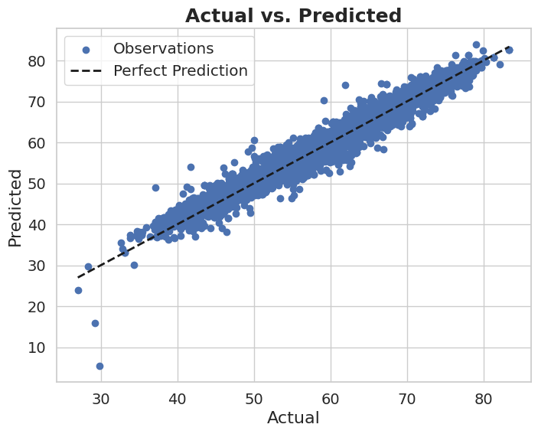
Prediction Result: Industrial Water Quality Index (indWQI)
LightGBM Regressor
XGB Regressor
MLP Regressor
Support Vector Regression (SVR)
Best Prediction
Worst Prediction
Notes:
Slide 15: Methodology
✨ Now I would like to introduce my teammate, ____.
He will continue with the next part of our presentation.

Slide 36
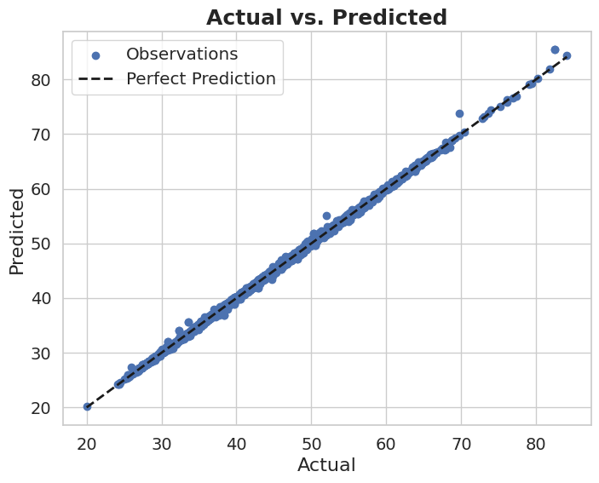
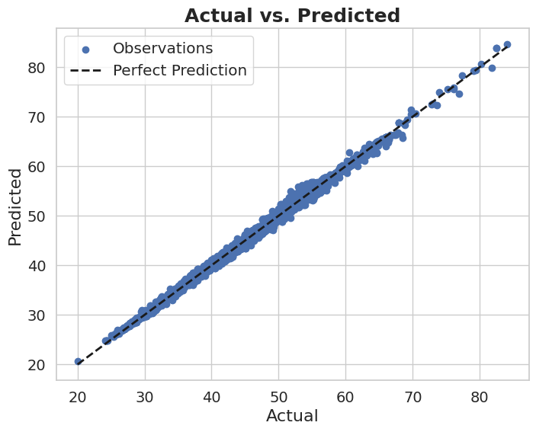
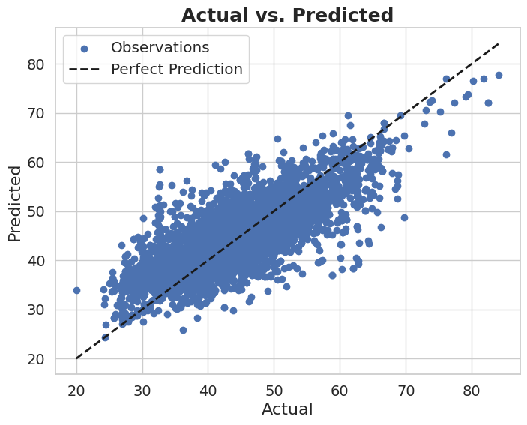
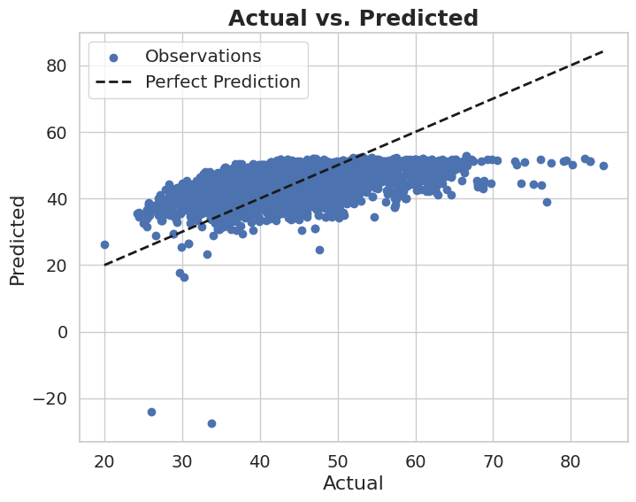
Prediction Result: Drinking Water Quality Index (DWQI)
XGB Regressor
Gradient Boosting Regressor
KNeighbors Regressor
Ridge Regression
Best Prediction
Worst Prediction
Notes:
Slide 15: Methodology
✨ Now I would like to introduce my teammate, ____.
He will continue with the next part of our presentation.

Slide 37
Prediction Result: Aquaculture Water Quality Index (AWQI)
XGB Regressor
Gradient Boosting Regressor
KNeighbors Regressor
Ridge Regression
Best Prediction
Worst Prediction
Notes:
Slide 15: Methodology
✨ Now I would like to introduce my teammate, ____.
He will continue with the next part of our presentation.

Slide 38
Intuition from the baselines
Ensemble based boosting models outperforms
Even some models providing overall R Square Ranged 0.98 - 1.00, They were doing bad in at least any of the four water quality index prediction (e.g.. high error in DWQI prediction)
This demand an universal multi-task framework that will be robust in universal WQI prediction. Thus, we plan to work on a Hybrid Multi-task Learning Framework in Milestone 3

Slide 39
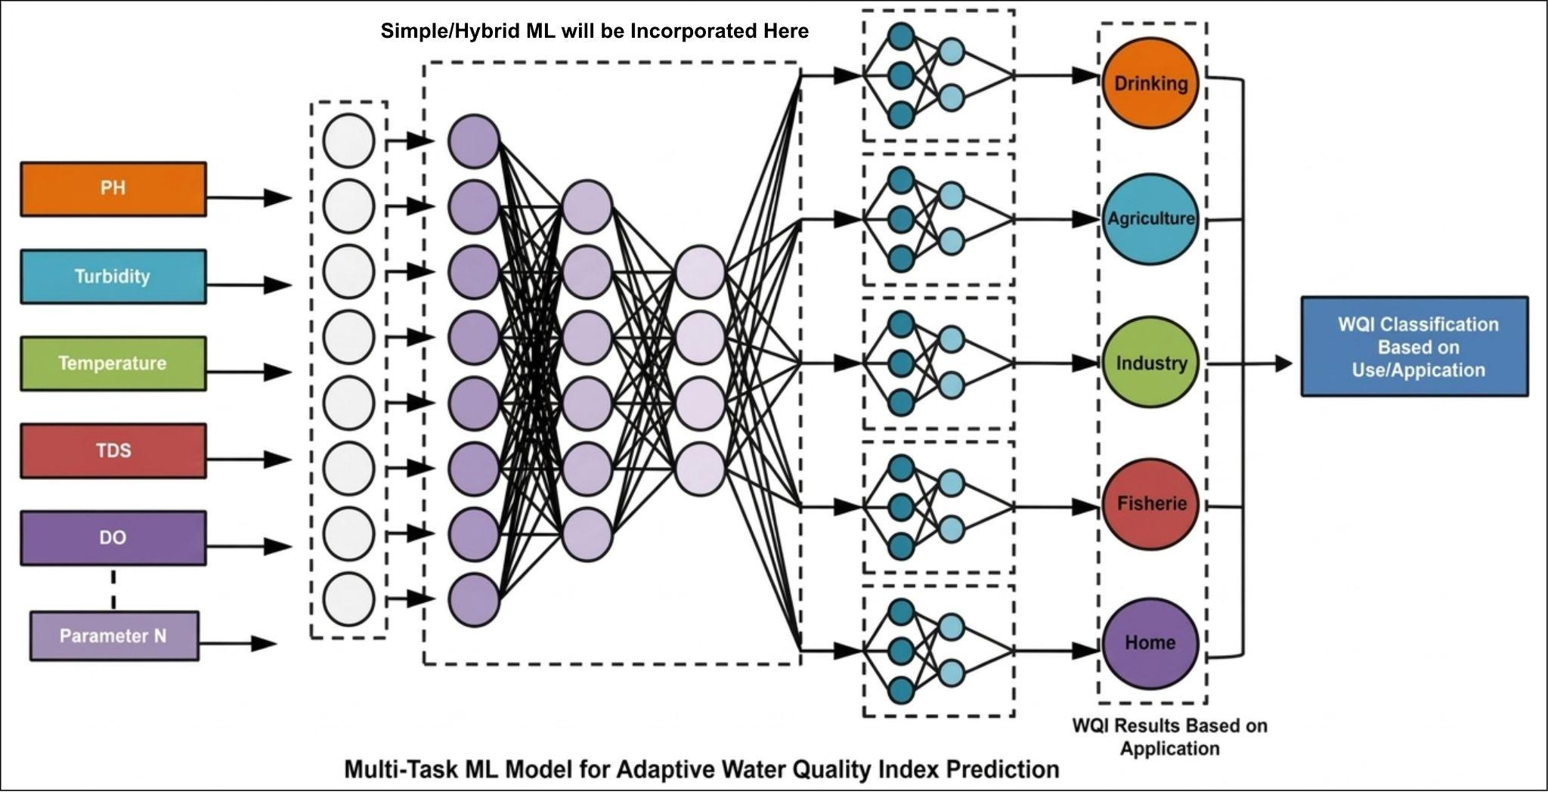
Tentative Plan - Hybrid MTL model for Milestone 3
Notes:
Slide 15: Methodology
✨ Now I would like to introduce my teammate, ____.
He will continue with the next part of our presentation.

Slide 40

Conclusion

Slide 41
Conclusion
Traditional WQI models summarize water quality using parameter selection, sub-index generation, weighting, and aggregation to produce a single representative score.
Machine learning models improve WQI prediction by capturing complex relationships among parameters, achieving high accuracy (84%–99%) in single task predictions. Very few multi-task ML models that serve multiple WQI output from one network.
No traditional multi user-specific WQI + No ML based implementation in contextware-multi user WQI framework.
Explainable AI (XAI) enhances model transparency by identifying key parameters influencing water quality predictions. Few studies incorporated this.
Dataset selection is critical, and the Ireland Catchments dataset provides comprehensive parameters suitable for multiple WQI calculations.
A key research gap is the lack of a universal, adaptive WQI model capable of supporting multi-use water environments across different regions.

Slide 42
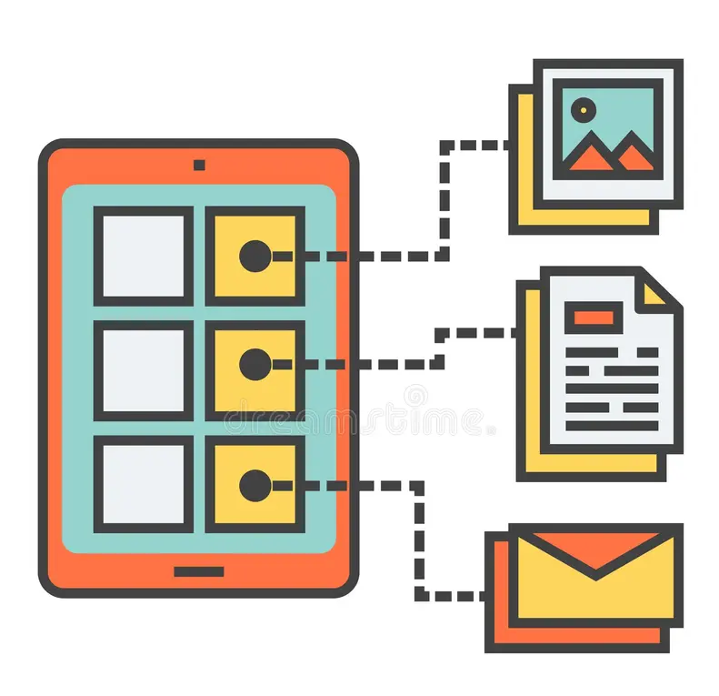
References

Slide 43
References (APA/IEEE)
[1] | Al Bataineh, A., Vamsi, B., & Smith, S. A. (2026). A Hybrid Machine Learning Framework for Water Quality Index Prediction Using Feature-Based Neural Network Initialization. IEEE Journal of Selected Topics in Applied Earth Observations and Remote Sensing.
[2] | Uddin, M. G., Nash, S., Diganta, M. T. M., Rahman, A., & Olbert, A. I. (2022). Robust machine learning algorithms for predicting coastal water quality index. Journal of Environmental Management, 321, 115923.
[3] | Z. Han, S. Zhang, L. He, and B. Zhu, "Predicting and investigating water quality index by robust machine learning methods," Journal of Environmental Management, vol. 381, 2025, Art. no. 125156.
[4] | Uddin, M. G., Nash, S., Rahman, A., & Olbert, A. I. (2023). Performance analysis of the water quality index model for predicting water state using machine learning techniques. Process Safety and Environmental Protection, 169, 808-828.
[5] | Mo, Y., Xu, J., Liu, C., Wu, J., & Chen, D. (2024). Assessment and prediction of water quality index (WQI) by seasonal key water parameters in a coastal city: Application of machine learning models. Environmental Monitoring and Assessment.
[6] | Singh, S., Das, A., & Sharma, P. (2024). Predictive modeling of water quality index (WQI) classes in Indian rivers: Insights from the application of multiple Machine Learning (ML) models on a decennial dataset. Stochastic Environmental Research and Risk Assessment, 38, 3221–3238
[7] | Ehteram, M., Ahmed, A. N., Sherif, M., & El-Shafie, A. (2024). An advanced deep learning model for predicting water quality index. Ecological Indicators, 160, 111806.
[8] | Satish, N., Anmala, J., Varma, M. R., & Rajitha, K. (2024). Performance of Machine Learning, Artificial Neural Network (ANN), and stacked ensemble models in predicting Water Quality Index (WQI) from surface water quality parameters, climatic and land use data. Process Safety and Environmental Protection, 192, 177-195.
[9] | Makumbura, R. K., Mampitiya, L., Rathnayake, N., Meddage, D. P. P., Henna, S., Dang, T. L., ... & Rathnayake, U. (2024). Advancing water quality assessment and prediction using machine learning models, coupled with explainable artificial intelligence (XAI) techniques like shapley additive explanations (SHAP) for interpreting the black-box nature. Results in Engineering, 23, 102831.
[10] | M. H. Nishat et al., “Comparative analysis of machine learning models for predicting water quality index in Dhaka’s rivers of Bangladesh,” Environmental Sciences Europe, vol. 37, p. 31, 2025.
[11] | Zhu, M., Wang, J., Yang, X., Zhang, Y., Zhang, L., Ren, H., Wu, B., & Ye, L. (2022). A review of the application of machine learning in water quality evaluation. Eco-Environment & Health, 1, 107-116. https://doi.org/10.1016/j.eehl.2022.06.001
[12] | U. Mohseni, C. B. Pande, S. C. Pal, and F. Alshehri, “Prediction of weighted arithmetic water quality index for urban water quality using ensemble machine learning model,” Chemosphere, vol. 352, p. 141393, 2024.

Slide 44
Thank you!
Any questions?

